Slide 1
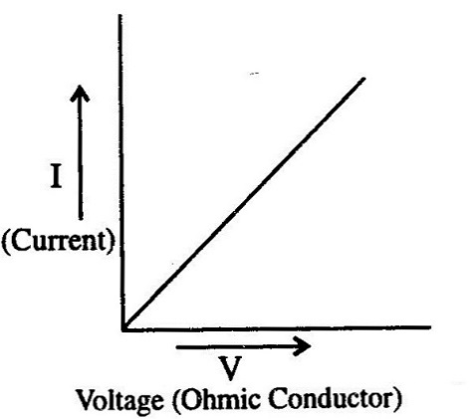

Ohmic and non Ohmic conductors
Is your work well presented?
Lesson Objectives
1. Describe the properties of Ohmic and non-Ohmic conductors.
2. Describe and explain which components display Ohmic and non-Ohmic properties.
3. Summarise why components display Ohmic or non-Ohmic properties.

Slide 2

Achieving Objective 1
1. Describe the properties of Ohmic and non-Ohmic conductors.
Ohm’s Law
Ohm’s Law relates to current and voltage (potential difference). It states that the current flowing through a conductor is directly proportional to the voltage across the conductor.
In other words, the current increases as the voltage increases. V = I R
Review
What have we found out?
Is your work well presented?

Slide 3
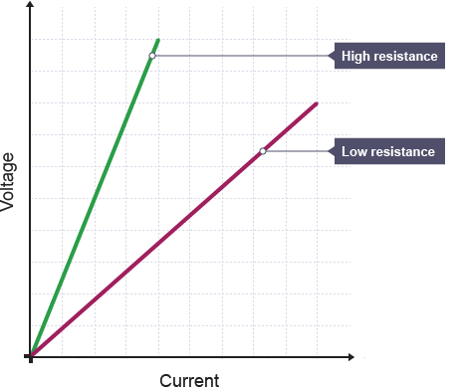
Achieving Objective 1
1. Describe the properties of Ohmic and non-Ohmic conductors.
Ohmic conductors
Describe what this graph tells you about Ohmic conductors?
Ohmic conductors
An ohmic conductor is a component that obeys Ohm’s law. A graph of voltage on the vertical axis against current on the horizontal axis (a voltage-current graph) gives a straight line with a positive gradient. The steeper the gradient, the higher the resistance will be.
Review
What have we found out?
Is your work well presented?

Slide 4
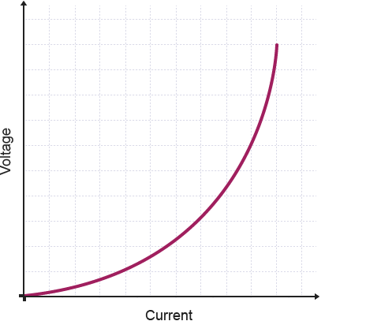
Achieving Objective 1
1. Describe the properties of Ohmic and non-Ohmic conductors.
Non-Ohmic conductors
Describe what this graph tells you about non-Ohmic conductors?
Ohmic conductors
An non-Ohmic conductor is a component that doesn’t obey Ohm’s law.
A bulb is a non-ohmic conductor. Its voltage-current graph does not follow a straight line. Instead, it gives a curve with an increasing gradient. It shows that the resistance increases as the current increases.
Review
What have we found out?
Is your work well presented?

Slide 5
Ohmic and non-Ohmic components
Achieving Objective 2
2. Describe and explain which components display Ohmic and non-Ohmic properties
Watch the demos carefully. Record what happens to the current. Describe the pattern in the current and explain if it shows Ohmic or non-Ohmic properties.
Wire at a constant temperature - Ohmic
Filament lamp – non-Ohmic
Diode – non-Ohmic
Review
What have we found out?
Is your work well presented?

Slide 6
Achieving Objective 3
3. Summarise why components display Ohmic or non-Ohmic properties
Ohmic and Non-Ohmic conductors
What causes the difference between Ohmic and Non-Ohmic conductors?
As the voltage across a non-ohmic conductor such as a bulb increases, the electrons carry more energy. Collisions pass on more energy. This makes the atoms vibrate more and more. This increases the resistance and the temperature, and causes the shape of the graph.
Review
What have we found out?
Is your work well presented?

Slide 7
Plenary
6 mark practice.
Explain how this circuit can be used to verify Ohm’s Law?
A
V
Lesson Objectives
1. Describe the properties of Ohmic and non-Ohmic conductors.
2. Describe and explain which components display Ohmic and non-Ohmic properties.
3. Summarise why components display Ohmic or non-Ohmic properties.
Review
What have we found out?
Is your work well presented?

Slide 8
Question mark scheme (green pen time)
Levels | Expected responses
Level 3 Answer identifies 5-6 key pointsneeded and applies knowledge of to explain the answer . With examples given . All information in answer is relevant, clear, organised and presented in a structured and coherent format. Specialist terms are used appropriately. Few, if any, errors in grammar, punctuation and spelling. (5-6 marks) Level 2 Answer identifies at least 3-4 key points and applies limited knowledge to explain the question asked. For the most part the information is relevant and presented in a structured and coherent format. Specialist terms are used for the most part appropriately. There are occasional errors in grammar, punctuation and spelling. (3-4 marks) Level 1 Answer includes 1-2 key points and some idea about the question asked. Answer may be simplistic. There may be limited use of specialist terms. Errors of grammar, punctuation and spelling prevent communication of the science. (1-2 marks) Level 0 Insufficient or irrelevant science. Answer not worthy of credit. (0 marks) | Ohm’s law states that current and voltage are directly proportional For fixed resistance, provided temperature is constant Ammeter in series, to measure current Voltmeter in parallel, to measure potential difference Potential divider used to change values of current and voltage Readings taken for whole range of potential divider Graph plotted of voltage against current Straight line through origin Proving directly proportional Gradient of graph is resistance of resistor

